Slide 1
Building Ties between the Academic Community and Industry
Mary E. Risner, Ed.D.
University of Niš/U.S. Embassy in Serbia
September 23, 2022

Slide 2
Overview
WHY connect with industry?
WHO are viable partners?
Academic: units in your university?
Work-world: industry focus of your region? Global firm presence?
HOW to connect with industry?
WHAT are activities for students?
Student ”branding”-professional profile building
Discussion/Sharing

Slide 3
Authentic/ real-world learning…
Preparing Students for Employability in the Global Workplace…
APPLYING what is learned in the classroom in the real-world…
Where will multilingualism take you?

Slide 4
Why?
Career readiness for students/builds their confidence
Visibility for university –attract employers
Internationalization of campus
Authentic professional learning experience for students and faculty
Much needed interaction between professional fields and academia to make curriculum more relevant
Students learn about jobs evolving in the industry
Future network of work contacts for students

Slide 5
Academic Partners at Your Institution
Who might be a likely collaborator?
What department or college might have mutual interests?
CLIL-connections

Slide 6
Identifying Potential Global Industry Collaborators
Bi-National Chambers/Industry Organizations:
https://www.ccfs.rs/ France/Serbia-Belgrade: in French or Serbian
https://www.sscc.rs/ Switzerland/Serbia-Belgrade: in English
“industry clusters have developed in Switzerland, such as life sciences, chemicals and pharmaceuticals, luxury watch industry, medical and environmental technology, machinery, electrical engineering and metals industry (MEM).”
http://ascconline.com.au/ Australia/Serbia-Melbourne: in English
U.S. Commercial Service

Slide 7
ALC Bridge (US)- Connecting Educators & Employers through Language Industry Associations
ALC Bridge-ELIA Exchange team
Indre@baltijosvertimai.eu
https://elia-association.org/
www.alcbridge.org
Focus on Translation/Interpretation/Localization

Slide 8
Reaching out to Industry/ Student Choice & Career Exploration
Students search binational/professional organizations of their interest
Students search global firms of interest/regional context
Faculty member explores possibilities of speakers (former students, local industry)
Students interview a global executive in their field of interest, reflection report
Consulting project possibilities for student teams
Identify industry journals for relevant articles/global leadership
https://www.census.gov/foreign-trade/balance/c4801.html

Slide 9
Centers for International Business Education & Research (CIBER)
https://us-ciberweb.org/
https://us-ciberweb.org/gsu-international-business-webinar-series/
https://globaledge.msu.edu/
https://globaledge.msu.edu/countries/slovakia

Slide 10
Potential Activities
Research
Research global firms in student region/country
Review
Review website in English vs native language, see job ads and skills needed
Create
Create LinkedIn account, build profile, network with groups
Develop
Develop their own ”elevator pitch”/build personal “brand”
Create
Create e-portfolio through Wix (or similar)
https://www.glassdoor.com/Explore/browse-companies.htm?overall_rating_low=3&page=3&locId=1655&locType=M&locName=Belgrade,%20Serbia%20Area

Slide 11
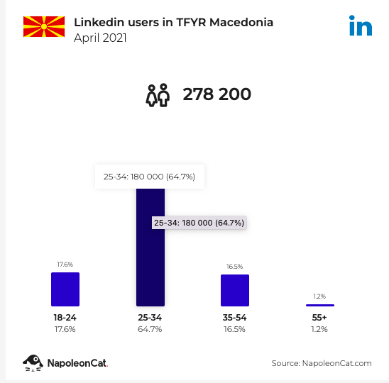
LinkedIn-Serbia/Macedonia https://napoleoncat.com/stats/
https://napoleoncat.com/stats/linkedin-users-in-tfyr_macedonia/2021/04/ (13% of population)
https://napoleoncat.com/stats/linkedin-users-in-serbia/2020/06/ (10% of population)

Slide 12
“LinkedIn” Around the World (Other similar platforms?)
https://www.apollotechnical.com/linkedin-users-by-country/

Slide 13
E-portfolios
Why e-portfolios?
In higher education institutions around the globe, ePortfolios are increasingly being viewed as a tool to not only improve the learning experience of students but also to enhance the employability, career development and professional identity of graduates. A reflection tool…
This is a rubric that gives an idea of the kinds of things that could be evaluated in a site. https://www.txcte.org/sites/default/files/resources/documents/Rubric-for-Career-Portfolio_0.pdf
Reflection on current skill
set, where to improve?

Slide 14
Possible Web Platforms/Examples
https://www.wix.com/ (Links to an external site.)
https://www.weebly.com/ (Links to an external site.)
https://wordpress.com/ (Links to an external site.)
UF Program Examples
https://internationalcenter.ufl.edu/global-learning/international-scholars-program/requirements/eportfolios

Slide 15
What to Include
- “About You”-Professional mission statement -Resumé targeted to specific job sectors and industries -Lists of skills and marketable qualities -Work experience and accomplishments - study abroad, internships, volunteer community service -Letters of recommendation, awards, certifications, references and testimonials
-Optional page with any project work worth sharing with future employer/interviewer
Hass (2016). https://blog.gettinghired.com/2016/9/your-eportfolio-essential-job-marketing-tool
The role of e-portfolios in supporting productive learning https://doi.org/10.1111/bjet.12316 Min Yang, Mui Tai, Cher Ping Lim

Slide 16
Elevator Pitch
What is it?
What value does it have?
How to do one, what to include? https://www.kent.edu/career/your-one-minute-elevator-pitch
Which technology tool to use?
FLIP (students can comment on each other)
Personal phone video
Voice Thread (written/verbal, students can comment)

Slide 17
Instructor Professional Development Ideas at LSP Events
*Pre-Conference Workshops
On-Site visit/tour at global firm
Company presentation on skills sought, positions needed
Q & A from instructors on employer needs
How can company and courses connect in the future for speakers/internships, etc.?
*Invited Industry Guest as Conference Keynote/Panel

Slide 18
Past Industry Sessions/Workshops for Language Instructors
American Association of Teachers of Spanish and Portuguese (AATSP) Annual Conference
Spanish for Careers in the U.S. Context. Full day Workshop and site visit to Latino marketing firm-Hispanidad. (2015)
Panama: The Crossroads of the Americas. Full day Workshop with visits to AmCham Panama and DELL-Panama.
Foreign Language Association(FFLA) Annual Conference
Meeting Industry Needs in the Global Workplace. Industry expert panel. (2014)
Trade & Logistics Workshops with site visits to Jacksonville Port (2013) and Tampa Port (2017)
Site Visit to NASA (2012)
https://www.youtube.com/playlist?list=PLylrmGqeIordhEBilIFOV2iva2uSc7sfq
*Student site visits

Slide 19
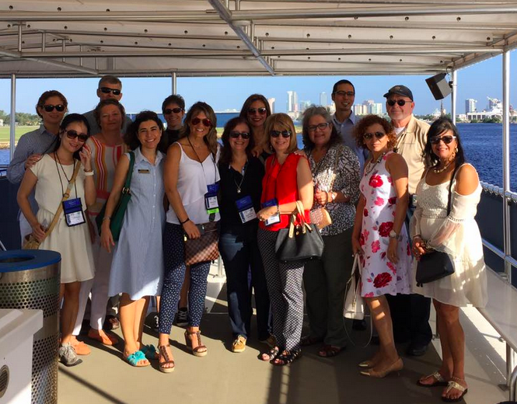
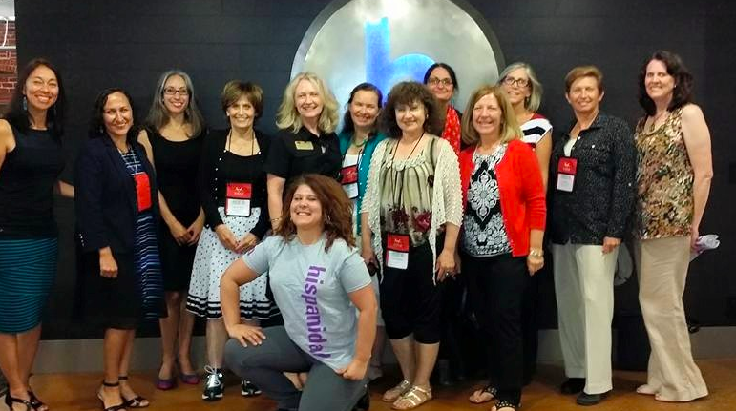
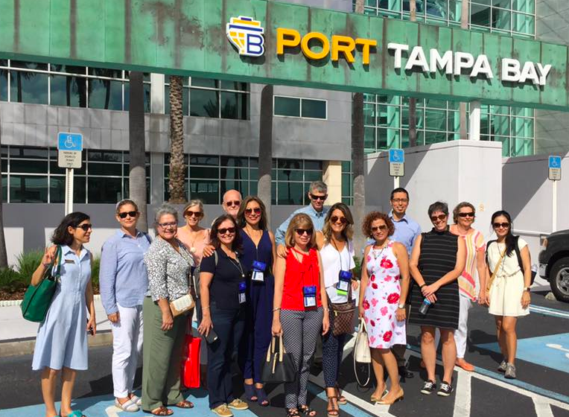
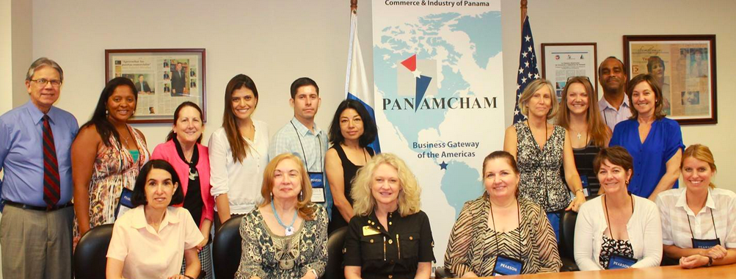

Slide 20
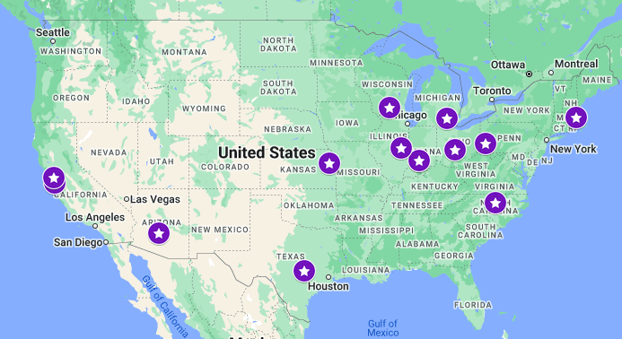
Eastern European Studies National Resource Centers in the U.S.
https://tinyurl.com/ake6nkdk
Dr. Dana Sapatoru, USDOE Program Officer -Dana.Sapatoru@ed.gov

Slide 21
Centers for International Business Education & Research (CIBER)- Global Teach Ag
https://us-ciberweb.org/
https://us-ciberweb.org/gsu-international-business-webinar-series/
https://globaledge.msu.edu/
https://globaledge.msu.edu/countries/slovakia
Global Teach Ag Ed Program https://globalteachagnetwork.psu.edu/glag/
Notes:
horticulture, land management, turf grass management, agricultural science, small animal care, machine and shop classes, health and nutrition, livestock management, and biology.

Slide 22
Thoughts/Comments? What might work in your region/context?
How do you connect your students to employers and future jobs?

Slide 23
Contact
mrisner@latam.ufl.edu
@langforcareers
www.nble.org

