Slide 1
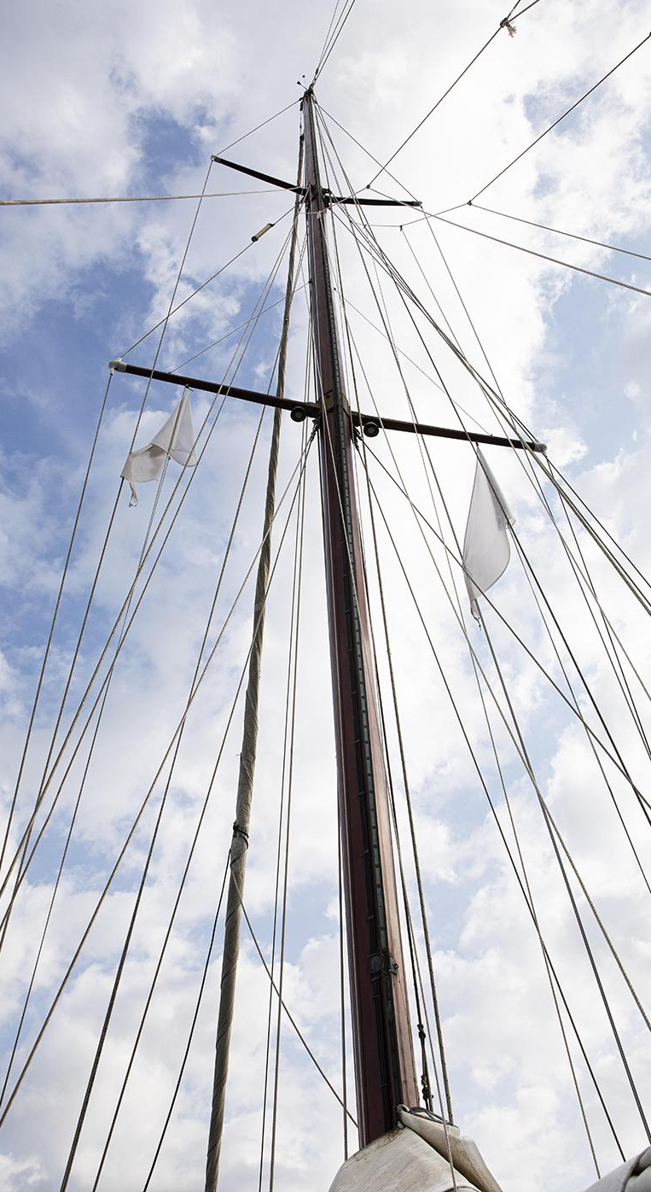
TESTING CORPUS LINGUISTICS METHODS IN ESP VOCABULARY TEACHING
Zorica Đurović Faculty of Maritime Studies Kotor, University of Montenegro Sanja Bauk Maritime Studies Department, Faculty of Applied Sciences, Durban University of Technology
ESP connections
Niš, 2022

Slide 2
CORPUS-BASED FREQUENCY WORD LISTS
General English word lists
Academic word list
Specialized word lists

Slide 3
MARINE ENGINEERING WORD LIST
2022
Corpus of marine engineering instruction books and manuals
1,769,821 running words (tokens)
337 headwords (word families) + 73 transparent compounds
Đurović, Z. (2021) “Corpus Linguistics Methods for Building ESP Word Lists, Glossaries and Dictionaries on the Example of Marine Engineering Word List“, Lexikos, 31, DOI: https://doi.org/10.5788/31-1-1647 (SSCI / A&HCI)

Slide 4
METHODOLOGY
2022
Data-driven learning (DDL) -7 main engine instruction books
Vocabulary Size Test (multiple choice)
General English Vocabulary Size Test (GEVST1 and GEVST2) (Nation & Beglar, 2007)
Technical English Vocabulary Size Test (TEVST1 and TEVST2).
Semi-structured interview

Slide 5
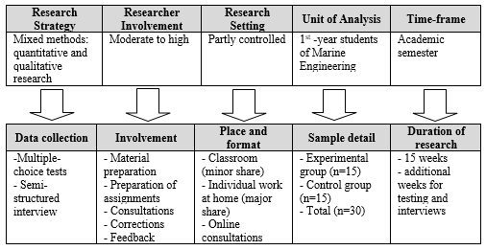
The strategy of the research conducted at the Faculty of Maritime Studies Kotor during the summer semester of 2020

Slide 6
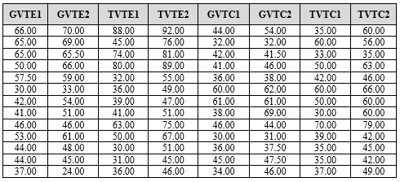
The results of the experimental and control group achieved on general and technical vocabulary size tests
ranging from 0.00 to 100.00

Slide 7
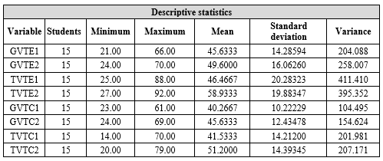
2022
The basic statistical indicators for each model variable

Slide 8
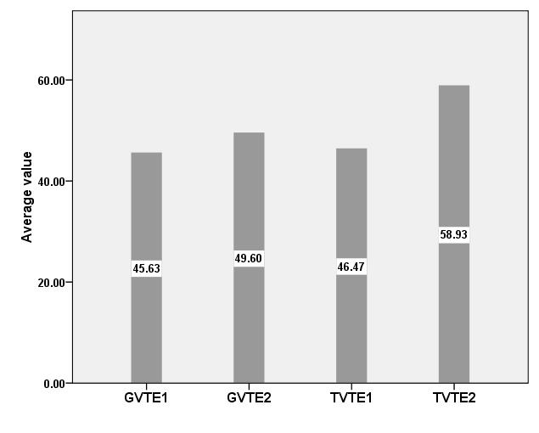
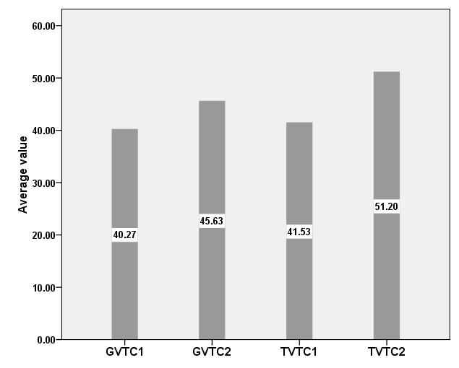
Score means of the experimental method
Score means of the control method

Slide 9
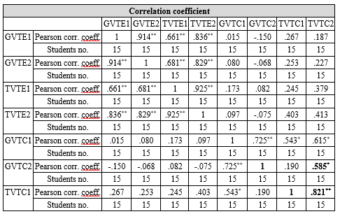
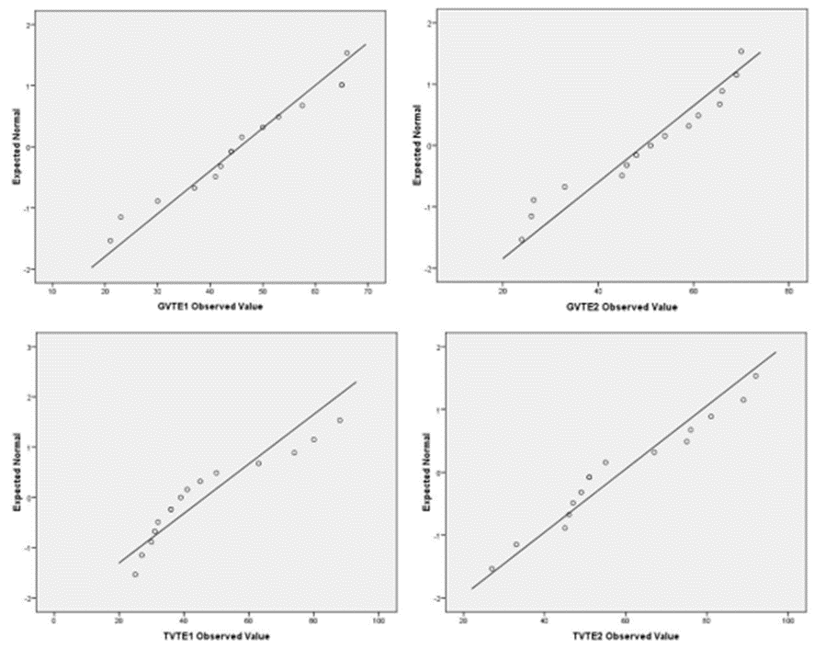
01
04
06
Correlation among the variables
About the project
You can describe the topic of the section here
You can describe the topic of the section here
You can describe the topic of the section here
Our team
You can describe the topic of the section here
The assessment of normality of the results in the case of the experimental group

Slide 10
DISCUSSION ON QUANTITATIVE ANALYSIS
additional motivation with innovative methods
individual approach (e.g. adding pictures of some components related to the assigned words and examples)
more individual work
required dedication and effort of the teacher
a more effective scoring in the case of the experimental group, working upon the DDL method.

Slide 11
QUALITATIVE RESEARCH
Variables | Categories
Student satisfaction | Participation in research during classes The most likable/easiest part of the research The least likable/the most difficult part of the research
Comparative impressions | Time spent Language teacher involvement / individual work
Opinions and suggestions | Method efficiency and additional suggestions Usefulness of the frequency vocabulary list from ship instruction books and manuals Other technical literature Additional suggestions for teaching/learning technical vocabulary

Slide 12
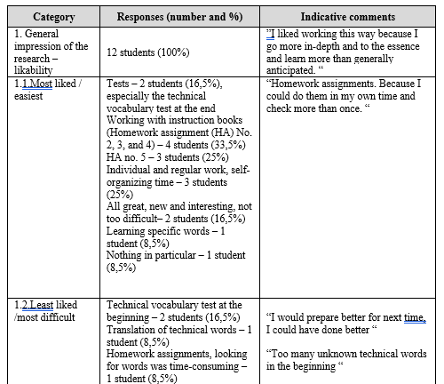
Mercury
Venus
Mars
Venus has a beautiful name and is the second planet from the Sun

Slide 13
CONCLUSION
TESTING CORPUS LINGUISTICS METHODS IN ESP VOCABULARY TEACHING
Testing contemporary corpus linguistics methods through the Data-driven learning method in the process of teaching/learning technical vocabulary.
The research confirmed that innovative and intensified communication with students brings about new forms of interaction and useful feedback.
The method encourages individual work and learners’ autonomy
This method overcomes the differences in language learning strategies preferred by the students individually.
Positive reactions of the students in regard to experimental and innovative teaching methods
Tailoring innovative methodologies and possibly develop similar but wider-range research.

Slide 14
THANK YOU FOR YOUR ATTENTION AND HAPPY JUBILEE TO THE CONFERENCE TEAM!
Zorica Đurović, PhD
Faculty of Maritime Studies Kotor
zoricag@ucg.ac.me
Sanja Bauk, PhD Durban University of Technology
bsanjaster@gmail.com

