Slide 1
The most important things I have learned during my first year of teaching
By Nina Stanković (BA in English Language and Literature)

Slide 2
introduction
Having been surrounded by the English language since the earliest childhood, never noticing the details of how much effort my teachers actually put in my attaining this knowledge
It took an abundance of different teaching techniques, materials and methods, that were subconsciously implemented in my mind, in order for a child, as small as I was, to learn to speak English at the level of a Native speaker.
Only when I became a teacher myself in 2021., did I get to experience the student-teacher relationship from a completely different perspective. This enabled me to come to three conclusions on what I consider to be the most important things when it comes to teaching not only children, but also adults.

Slide 3
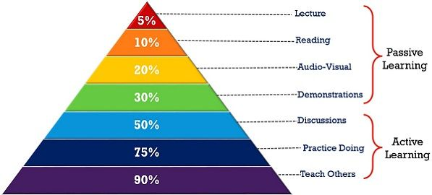
1. Both children and adults learn through play
. "Language is a valuable tool that we should arm children with. As such, it should be continuously improved so they can better communicate with others as they progress playtime activities to more diverse learning concepts and situations through a variety of fun and entertaining methods." The British Council
It has come as a great surprise to me how important it is to play while learning, especially with adults. Children subconsciously sing songs and repeat the sounds they hear without asking any additional questions. If the topic is something of their interest, it would stun so many people just how big of a vocabulary the children have unconsciously attained.

Slide 4
The role of the teacher is to creatively motivate children to explore and experience this part of their minds, which naturally acquires foreign languages and new information faster than the adult mind.
Regarding adults, studies have found that playful approach to learning can be just as effective as the more traditional methods.
"Guided play describes playful activities which are focused on a learning goal, but allow children and adults to try things out for themselves. If the students are given the freedom to explore, but with some gentle guidance, it can be very good for their education—perhaps in some cases better than direct instruction." academics from the Play in Education, Development and Learning (PEDAL) Center at the Faculty of Education, University of Cambridge.
If a teacher introduces the topic as something close and familiar, through guessing games, movies, real-life conversations, they will not only learn faster, but also implement this new knowledge in their everyday life.

Slide 5
2. The students’ Fear of failure
It is particularly exciting to note that teaching strategies used in the classroom can and do make a difference to students' self-efficacy. (Fencl and Scheel, 2005)
The greatest problem with a student acquiring a new language, from my experience, is the fear of failure. This negative mindset is the reason why so many people give up on learning a new language without even giving it a try.
Remember what Thomas Edison said: “I have not failed 10,000 times — I’ve successfully found 10,000 ways that will not work.”

Slide 6
Thus, the second most important thing is that the teacher has the power to completely change someone’s perception of themselves, and through encouragement and understanding help the student reach their goal.

Slide 7
3. The teacher’s role beyond teaching
The final argument that I would like to point out is that students will not remember you for the subject you have taught them, but for the atmosphere they felt when they entered the classroom.
The teacher’s roles:
Plan in a flexible and responsive way
Be a co-learner
Problems of understanding something are good teachable moments
Provide opportunities for students to express how they feel
Guide students through a variety of different processes
Establish psychological safety
Encourage students to investigate their ideas.

Slide 8
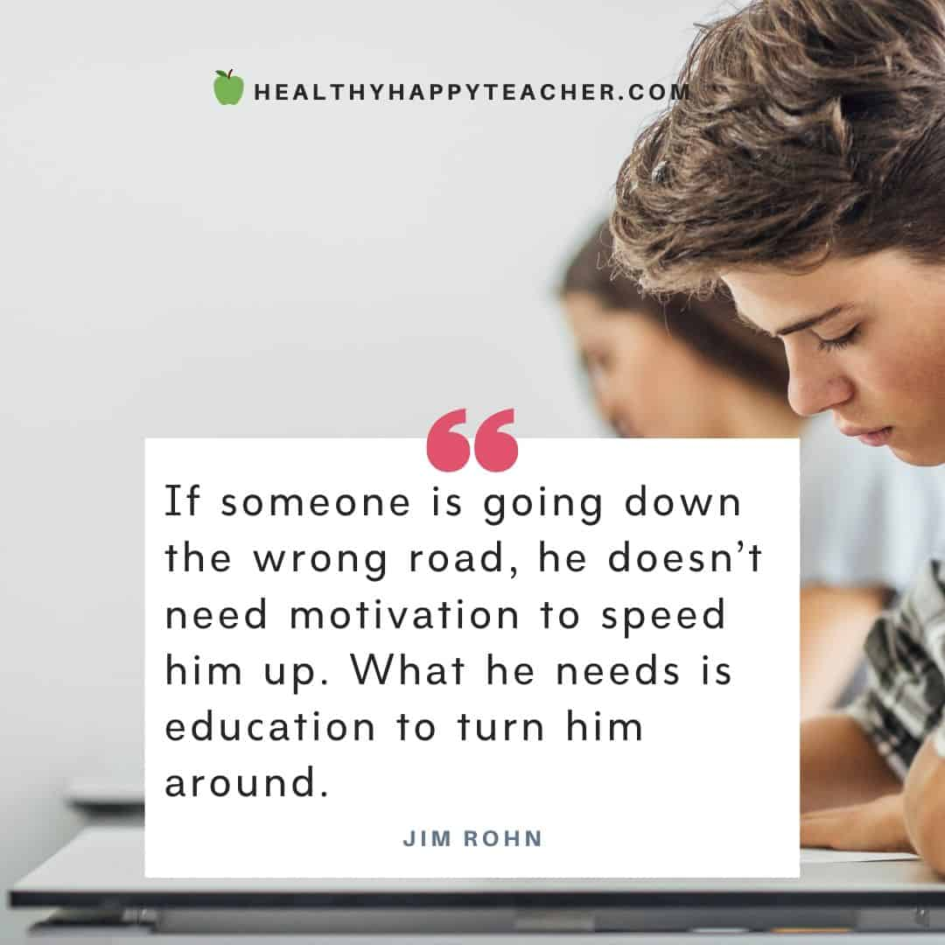
The teacher’s role in the eyes of the students is much more important than we are able to imagine.
Often times teachers tend to forget that their students, both children and adults, have their own busy lives outside of the classroom.
This is why when a student enters the classroom and feels that even if they make a mistake or if they are simply not on top of their game, they should know that the teacher is there to guide and support them.

Slide 9
In conclusion, in my first year of teaching I have learned that students are not jus passive consumers of knowledge. Teachers are raising a new generation of thinkers, creators, leaders, individuals who are vital for the society as a whole, making up the social, economical and cultural future of our world.
This is why the teacher’s role is so important. It can result in making a difference in individuals’ lives, shaping them into people who will carry the knowledge you have given them through their lifetime and pass it on to new generations.
As Henry Brooks Adams said “A teacher affects eternity, he can never tell where his influence stops.”

Slide 10
Thank you for your attention!

